Slide 1



Introduction To Limerick Institute of Technology
Marie Walsh
FICTION Project Partners’ Kick-off Meeting
November 28th – 29th, Florence, Italy
Project Number:
2018-1-SE01-KA201-039098

Slide 2
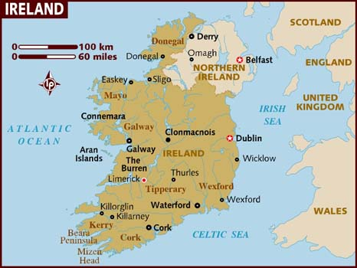
Limerick Institute of Technology: LIT
Institution of Higher Education in Limerick, Ireland.
One of 14 member institutions of the Technological Higher Education Association (THEA).
Campuses in Limerick city, Thurles and Clonmel in County Tipperary, Ennis in County Clare. Approximately 6,500 students.
Project Number:
2018-1-SE01-KA201-039098

Slide 3
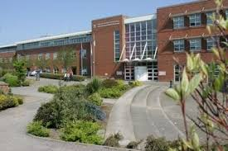
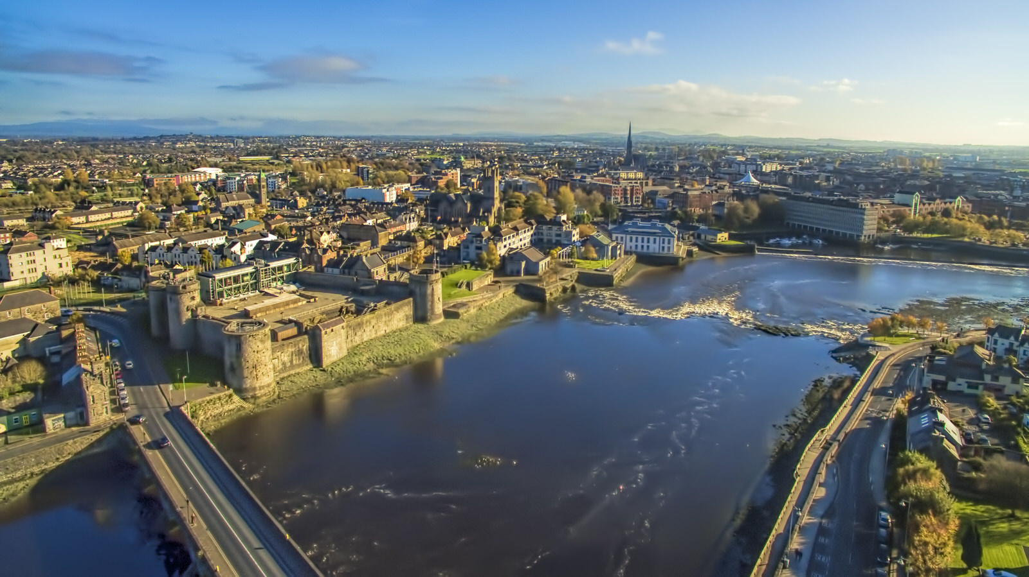
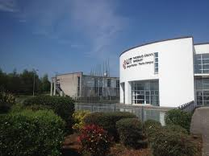
Limerick Institute of Technology: LIT
Main campus LIMERICK city
Base for other STEM, ICT and project management THURLES, Tipperary
Project Number:
2018-1-SE01-KA201-039098

Slide 4
Courses in LIT
Courses at Level 6 (Higher Certificate) through Level 10 (PhD) whilst also catering for craft apprentices and adult and continuing education.
Faculties:
Applied Science Engineering and Technology
Business and Humanities
Art and Design
Many programmes require competency in ICT.
ICT skills training embedded in programmes
Project Number:
2018-1-SE01-KA201-039098

Slide 5
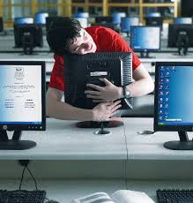
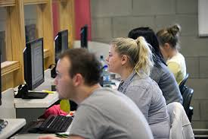
ICT in LIT: in line with Active Learning Philosophy
Underpinned by continuous professional staff development, e.g. workshops and an online repository of active learning strategies.
Staff sharing in Staff Development days, Conversations in the Consortium, Lunch-bites
EPI*STEM
LIT lecturers have recognised ICT as being a basis for development of transferable skills and are supportive of the student learning in these skills across subject areas.
Project Number:
2018-1-SE01-KA201-039098

Slide 6
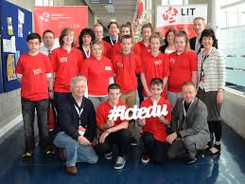
LIT: ICT in Education Conference #ictedu
LIT Thurles hosts annual event
Linked with a Maker Meet
ethos of the conference is
“by teachers, for teachers”.
attendees from primary, secondary and third level as well as adult and community education.
for anyone who is interested in integrating technology into their teaching and learning to meet with others to learn and to share
Project Number:
2018-1-SE01-KA201-039098

Slide 7
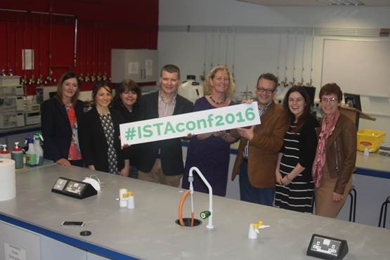
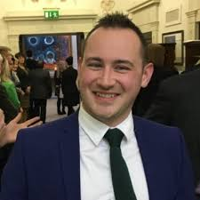

LIT: networking with science teachers
LIT hosts Irish Science Teacher Association (ISTA) meetings and workshops
Fusion of Science and ICT in Royal Society of Chemistry Learn Chemistry workshops
Project Number:
2018-1-SE01-KA201-039098

Slide 8

LIT: participation in EU programmes
Has participated in Comenius, Erasmus and Leonardo as well as FP7 and IEE projects both as project co-ordinator and project partner.
Chemistry is all Around Us Network, funded in the framework of the Lifelong Learning Programme – Comenius sub programme – Networks Action
Project Number:
2018-1-SE01-KA201-039098

Slide 9

LIT: participation in EU programmes
Has participated in Comenius, Erasmus and Leonardo as well as FP7 and IEE projects both as project co-ordinator and project partner.
E-learning from Nature, Erasmus+ KA2 project, which looked at the use of digital and other media to promote alternative methods of teaching and learning science.
Project Number:
2018-1-SE01-KA201-039098

Slide 10
Thank You for Your Attention
Marie Walsh
FICTION Project Partners’ Kick-off Meeting
November 28th – 29th, Florence, Italy
Project Number:
2018-1-SE01-KA201-039098

